Slide 1
Human Mobility Under Disaster Relief
with Social Media Mining
Lu Cheng, Jiayong Mo, Linzhen Luo, Bernard Ngabonziza

Slide 2
Research Questions
What are the intrinsic states underlying people’s movements?
To name a few, a state could be working at office in the morning, exercising at gym at noon, or having dinner with family at night. We want each state to provide a unified view regarding a user’s activity: (1) where is the user; (2) what is the user doing; and (3) when does this activity happen.
How people’s locations, interactions, and their social ties interplay with each other?
How do people move sequentially between those latent states?
For example, where do people working in Manhattan usually go to relax after work? and what are the popular sightseeing routes for a one-day trip in Paris? We aim to summarize people’s transitions between the latent states in a concise and interpretable way.

Slide 3



OUTLINES
• Data Collection & Exploration
• Machine Translation
• Human Mobility Model
• Results & Analysis
•Conclusion & Future Works

Slide 4
Data Crawling
Tweeter Track

Slide 5
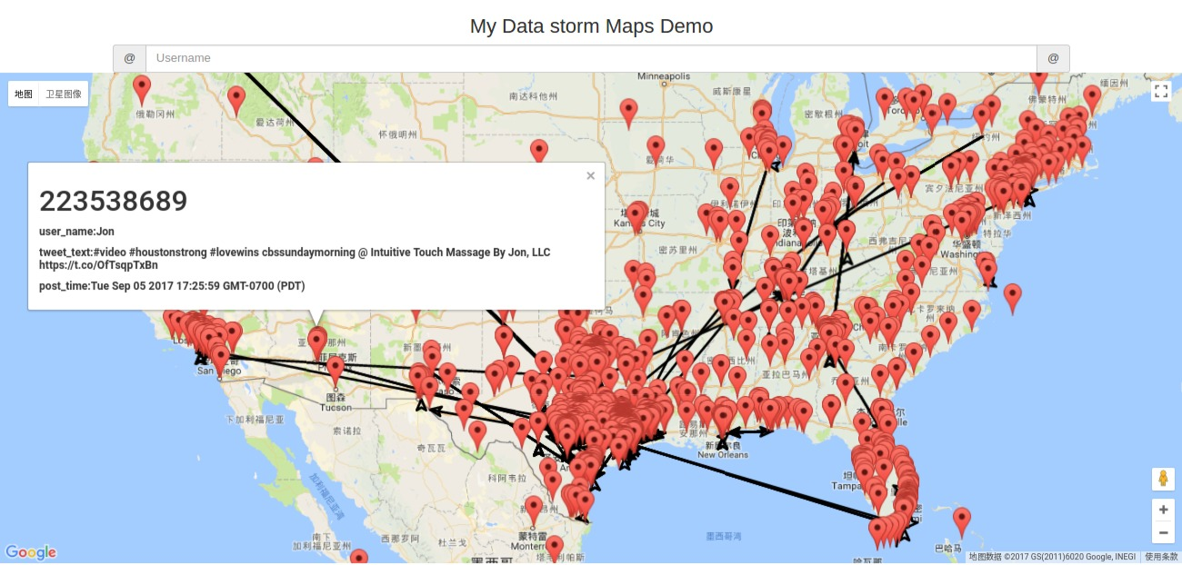
Location Estimation
Harvey Hurricane
Location Information Overview
The geo-tagged tweets shown in the map during the time of Harvey hurricane,
but what about those tweets without geo-tag?

Slide 6
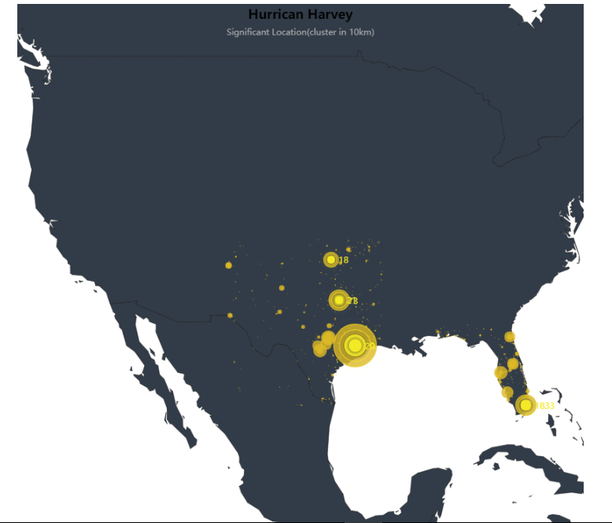
Significant Location
Data from Texas and Florida
The yellow point shows some significant spots in the map.
The bigger the spot is, the more important that place is.

Slide 7
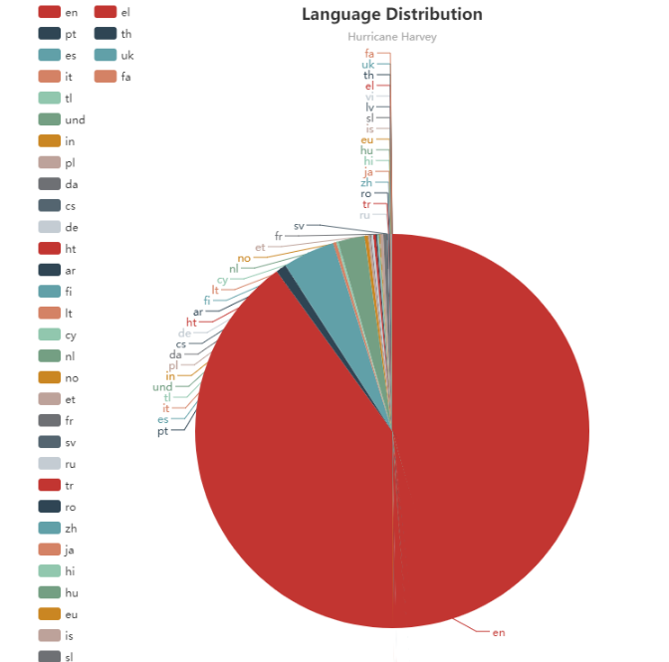
Language Distribution
English covered the largest the portion.
Spanish is the second largest portion.

Slide 8
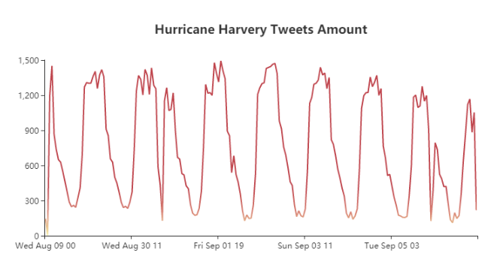
Temporal information
The tweet data distribution based on the time

Slide 9
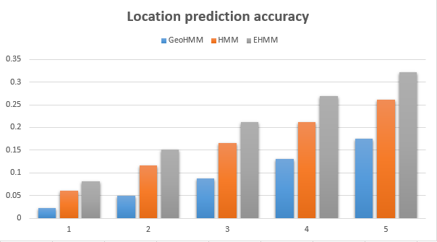
Location Estimation
The accuracy climbs up with the different numbers of K state and different prediction method.

Slide 10

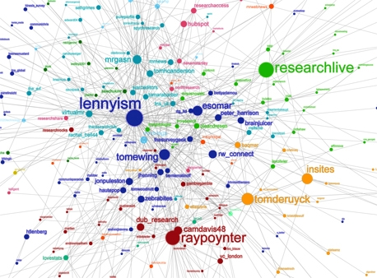
SOCIAL NETWORK

HIGHLIGHTS
Then how do make it come true?
Friend prediction is based on text similarity and interaction frequency.
location is inferenced from friend’s geo-tagged tweets.
Features
Regression Decision Tree
Belief Propagation
Dynamic Bayesian Network

Slide 11
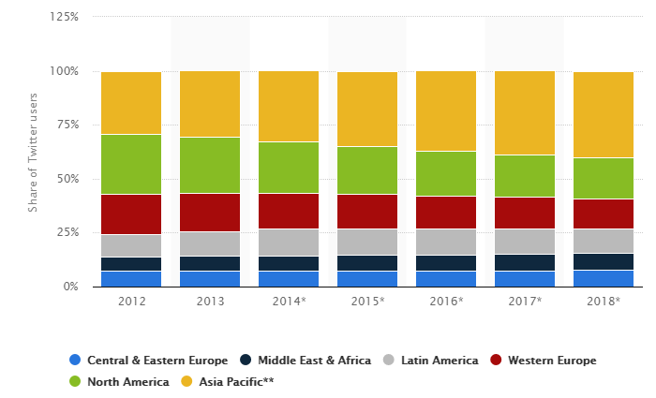
Machine Translation

Slide 12

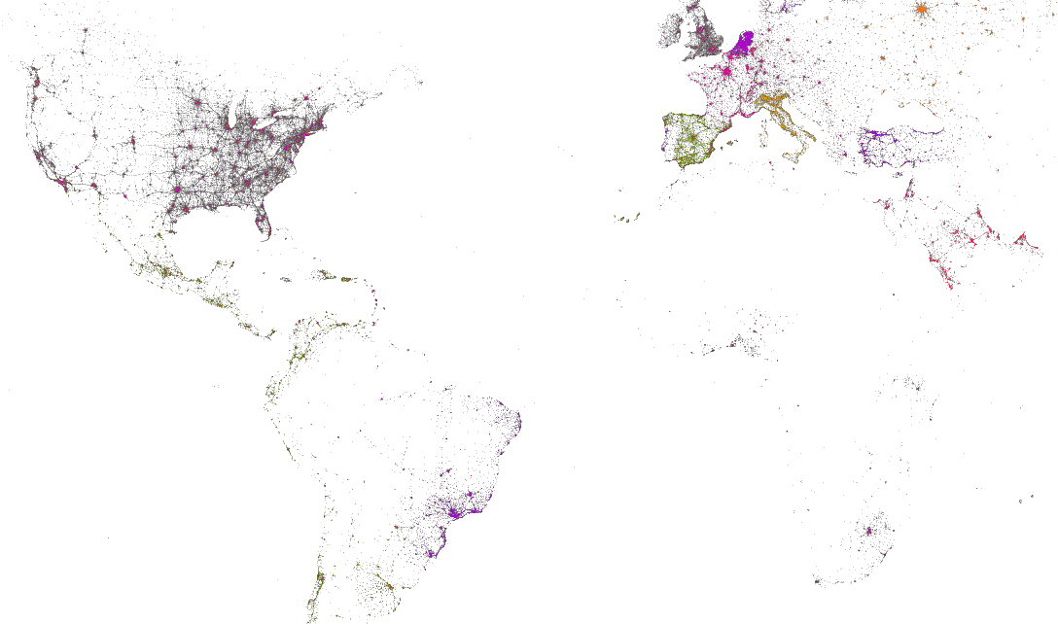
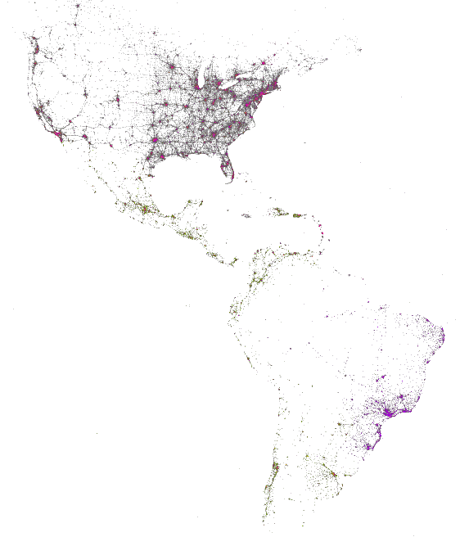
Languages On Twitters

Slide 13
Q&A

